Slide 1

AutoShield
Real-Time Cloud Misconfiguration Detection & Intelligent AlertingServerless | Scalable | Secure | Ready for Production

Slide 2
The Growing Challenge of Cloud Misconfigurations
In dynamic cloud environments, misconfigurations pose significant security risks. Accidental exposures, such as publicly accessible S3 buckets, overly permissive security groups, and misconfigured IAM roles, can lead to data breaches and compliance violations. A critical gap often exists in real-time visibility, leaving organizations vulnerable to these overlooked security flaws.
Public S3 Buckets
Permissive Security Groups
Misconfigured IAM Roles
Unintended public access to sensitive data stored in S3.
Security groups allowing broad, unnecessary inbound access.
IAM roles with excessive permissions, violating least privilege.

Slide 3

The Peril of Real-Time Exposure
A single misconfiguration can expose an organization to immediate threats. Imagine an S3 bucket containing customer data inadvertently becoming public, or an EC2 instance with an open port allowing unauthorized access. The time between misconfiguration and detection is a critical window for attackers. Real-time alerting is not just a feature; it's a necessity to prevent catastrophic data breaches.
Public S3 Bucket:
Customer data or proprietary code instantly exposed to the internet. Search engines or malicious actors can quickly discover and exploit these vulnerabilities.
Open EC2 Port:
Unrestricted network access to critical application servers, potentially leading to system compromise and data exfiltration.
IAM (Identity & Access Management):
Users without MFA, policies that allow wildcard access, iam-user-mfa-enabled, iam-policy-blacklist.
RDS (Relational Database Service):
Protect your data with encryption at rest and keep it secure by avoiding public subnets. Our encrypted RDS storage and restricted RDS instance public access enhance the security of your information.
EBS (Elastic Block Store):
Volumes not encrypted, encrypted-volumes

Slide 4



AutoShield: Our Serverless Solution
AutoShield is a robust, serverless security monitoring system designed to detect and alert on AWS resource misconfigurations in real-time. Leveraging native AWS services, it provides a lightweight, scalable, and production-grade solution for continuous cloud compliance.
Serverless Architecture
Highly Scalable
Production-Grade Security
No servers to provision or manage, reducing operational overhead and costs.
Dynamically scales with your AWS environment, from a few resources to thousands.
Built with security best practices to protect your cloud infrastructure.

Slide 5



AutoShield: Project Architecture
AutoShield's architecture is built on a seamless integration of core AWS services, enabling efficient real-time detection and alerting. This design ensures high availability and minimal latency for security events.
AWS Config
Monitors resource configuration changes.
EventBridge
Routes configuration change events.
Lambda Function
Processes events and evaluates compliance.
SNS
Sends real-time email alerts.
DynamoDB
Logs all detected violations.

Slide 6





Core Features
AutoShield provides comprehensive features designed to keep your cloud environment secure and compliant, ensuring that any deviation from your security posture is immediately addressed.
Real-time Detection of Misconfigurations
Event-Driven Alerts
Modular Lambda Function (Python)
Leverages Amazon EventBridge to trigger Lambda functions based on specific configuration changes. This ensures that alerts are only generated when relevant events occur.
Utilizes AWS Config rules to continuously monitor resource compliance. Detects changes as they happen, ensuring immediate awareness of security risks.
A highly efficient and extensible Python Lambda function performs the compliance evaluation. Its modular design allows for easy addition of new detection rules.
Logging Violations to DynamoDB
Email Alerts via SNS
Critical alerts are sent directly to designated security teams via Amazon SNS, ensuring immediate notification and enabling rapid response to incidents.
All detected misconfigurations are securely logged in a DynamoDB table for auditing, historical analysis, and compliance reporting.

Slide 7
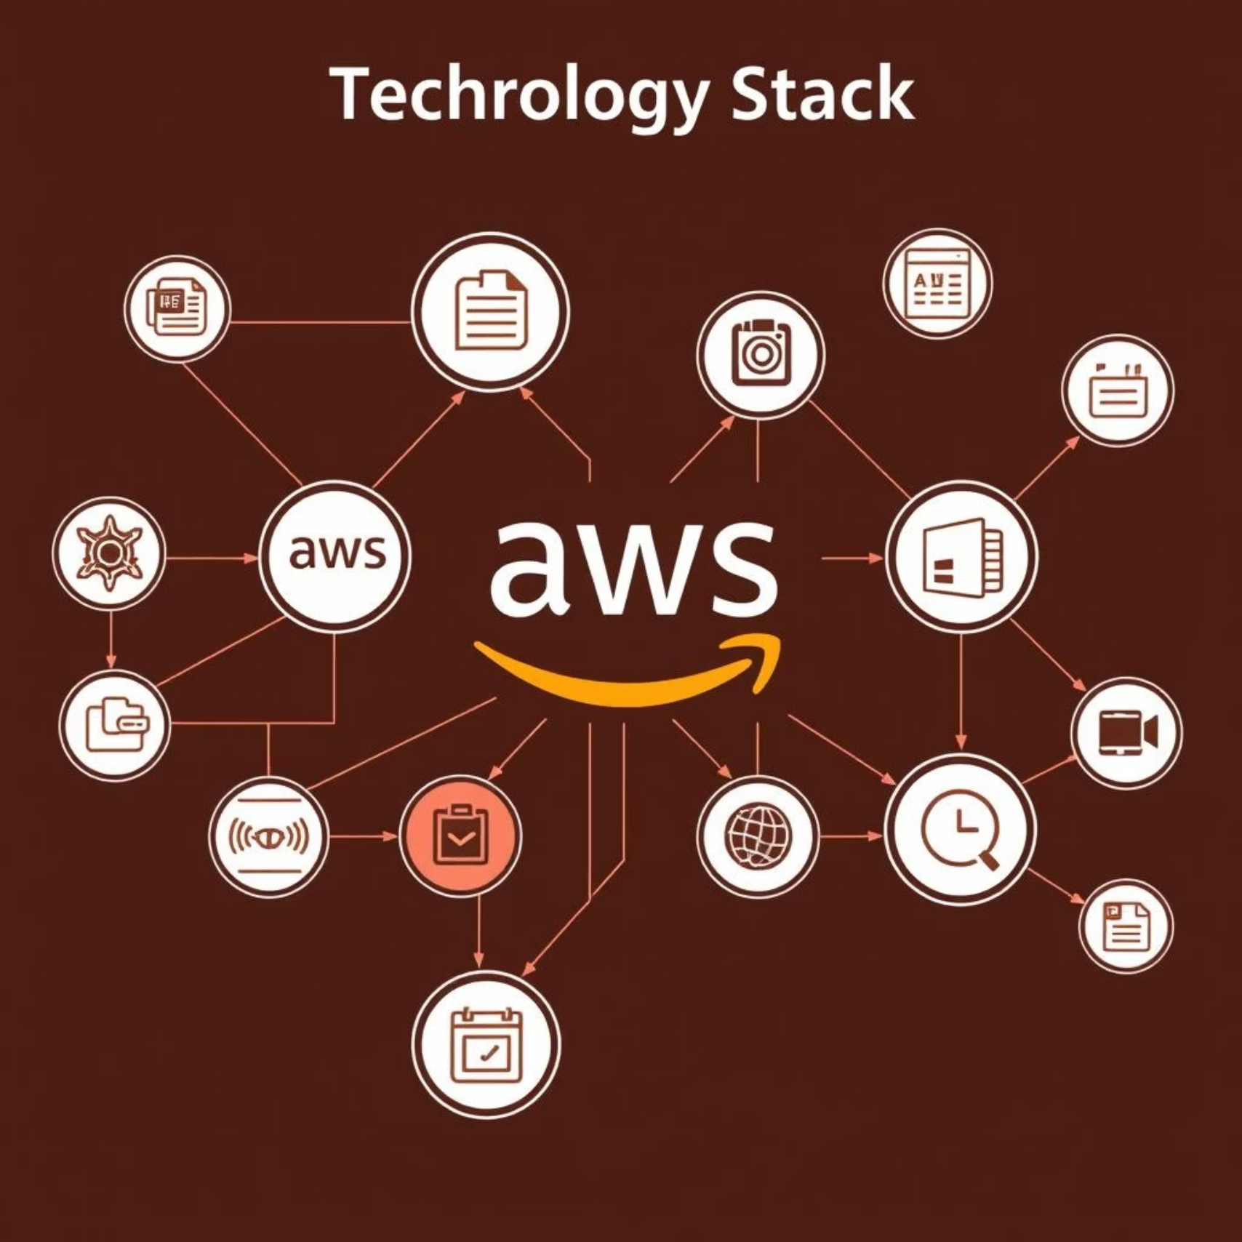
Robust Technology Stack
AutoShield is built entirely on native AWS services, ensuring seamless integration, high performance, and robust security without introducing external dependencies.
Core Services:
AWS Config: Continuous monitoring of AWS resource configurations.
Amazon EventBridge: Serverless event bus for routing events.
AWS Lambda (Python): Serverless compute for detection logic.
Amazon SNS: Simple Notification Service for alerts.
DynamoDB: Fully managed NoSQL database for logging violations.
IAM Roles/Policies: Secure access control and permissions.

Slide 8






Security & IAM Considerations
Security is paramount in AutoShield's design. We adhere strictly to AWS best practices and the principle of least privilege, ensuring that the system itself does not introduce new vulnerabilities.
No Third-Party Dependencies
AutoShield relies solely on native AWS services, eliminating the risk associated with external libraries or vendors.
Scoped IAM Roles
Lambda execution roles are precisely scoped, granting only the minimum necessary permissions to perform their functions.
Principle of Least Privilege
All components are configured with the strictest permissions required, minimizing the attack surface.

Slide 9
Impact & Value Delivered
AutoShield empowers DevOps and SecOps teams with critical visibility and proactive protection, transforming cloud security from reactive to preventative.
100%
90%
50%
20%
Visibility
Risk Reduction
Compliance
Operational Efficiency
Achieve complete oversight of your AWS resource configurations, eliminating blind spots.
Significantly reduce the risk of accidental data exposure and security incidents.
Improve regulatory compliance posture with continuous monitoring and logging.
Automate detection, freeing up security teams to focus on higher-value tasks.
This project is ideal for interview discussions, a strong portfolio addition, and a practical solution for real-world cloud security deployments.

Slide 10
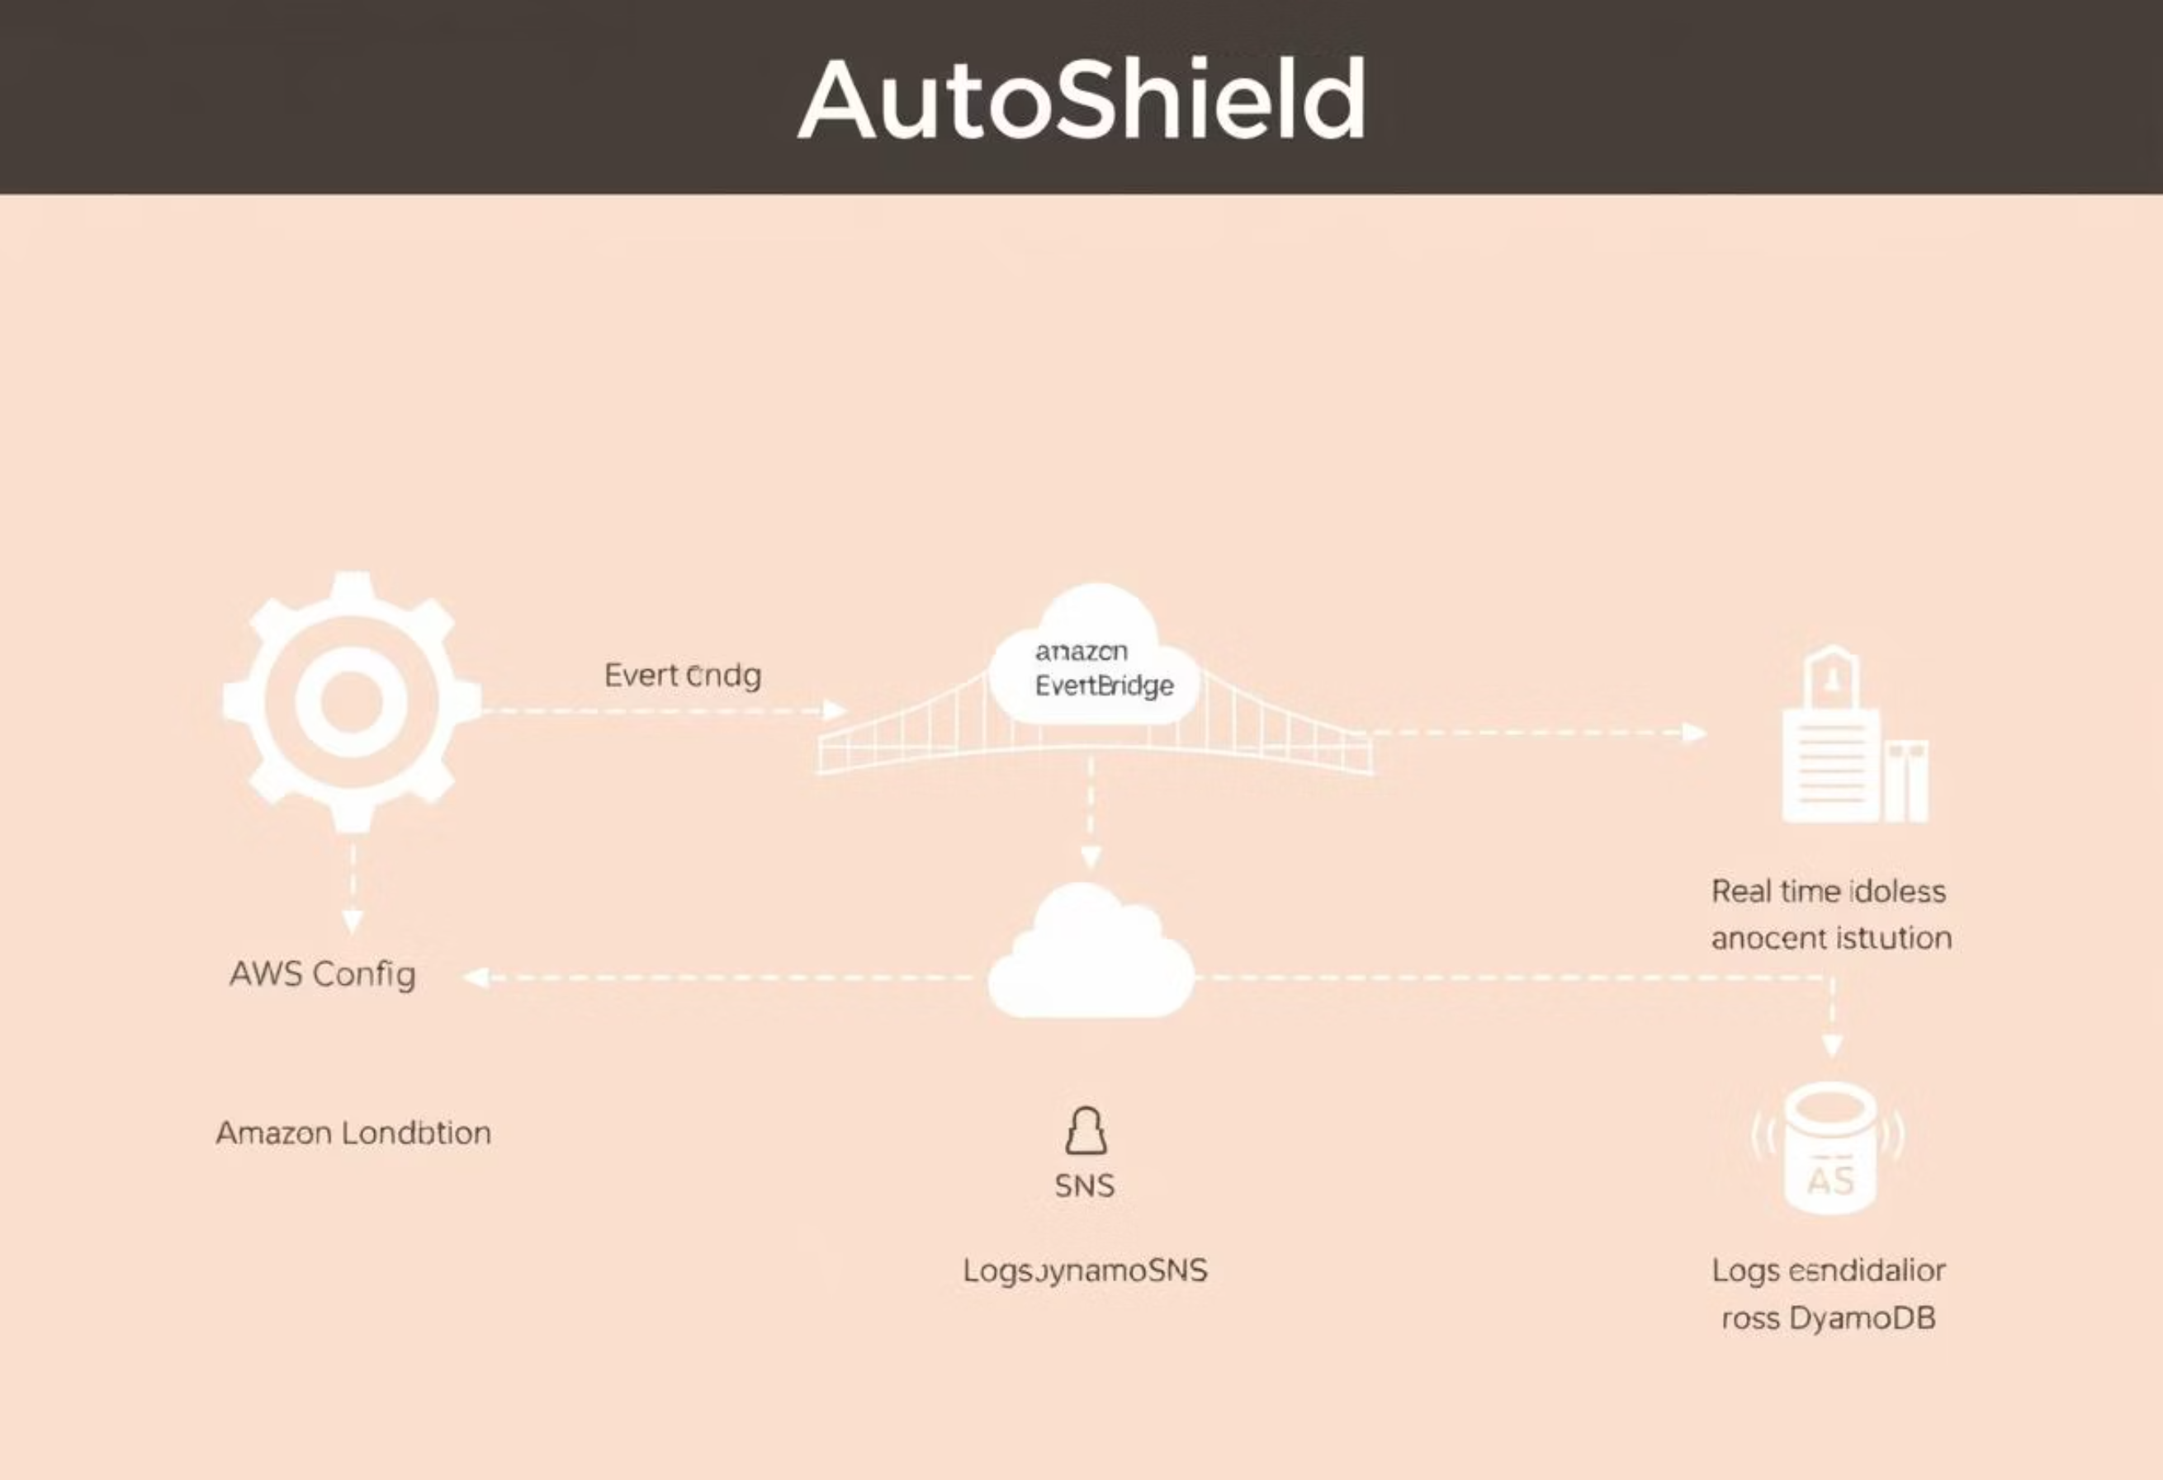
AutoShield: Project Architecture

Slide 11

Future Enhancements
AutoShield is designed for continuous evolution, with exciting future enhancements planned to extend its capabilities and user experience.
Auto-Remediation Module: Implement automatic fixes for common misconfigurations, e.g., setting public S3 buckets back to private.
Slack Alert Integration: Integrate with Slack for real-time team notifications, providing a more collaborative alerting mechanism.
DynbDashboard (DynamoDB-powered UI): Develop a user interface to visualize violations, trends, and compliance posture, built directly on DynamoDB data.
Full IaC Deployment (SAM/CDK): Provide complete Infrastructure as Code templates using AWS SAM or CDK for easy, repeatable deployment across accounts.

Slide 12
CONCLUSION
“AutoShield isn’t just a project — it’s a real-world cloud defense mechanism.”
🌐 100% Serverless — no maintenance, no overhead
⚡ Real-time — responds instantly to critical misconfigurations
🔁 Modular & Scalable — plug-and-play in any AWS environment
🔒 Secure by Design — principle of least privilege enforced throughout
🧠 Built to Learn, Deploy, and Impress — from classrooms to production
📧 Contact
Manas GantaitAspiring Cloud & DevSecOps Engineer📬 Email: imgantait@gmail.com

Slide 13
Thank You !

